Slide 1
Operating Systems
File System
Liu Fagui

Slide 2
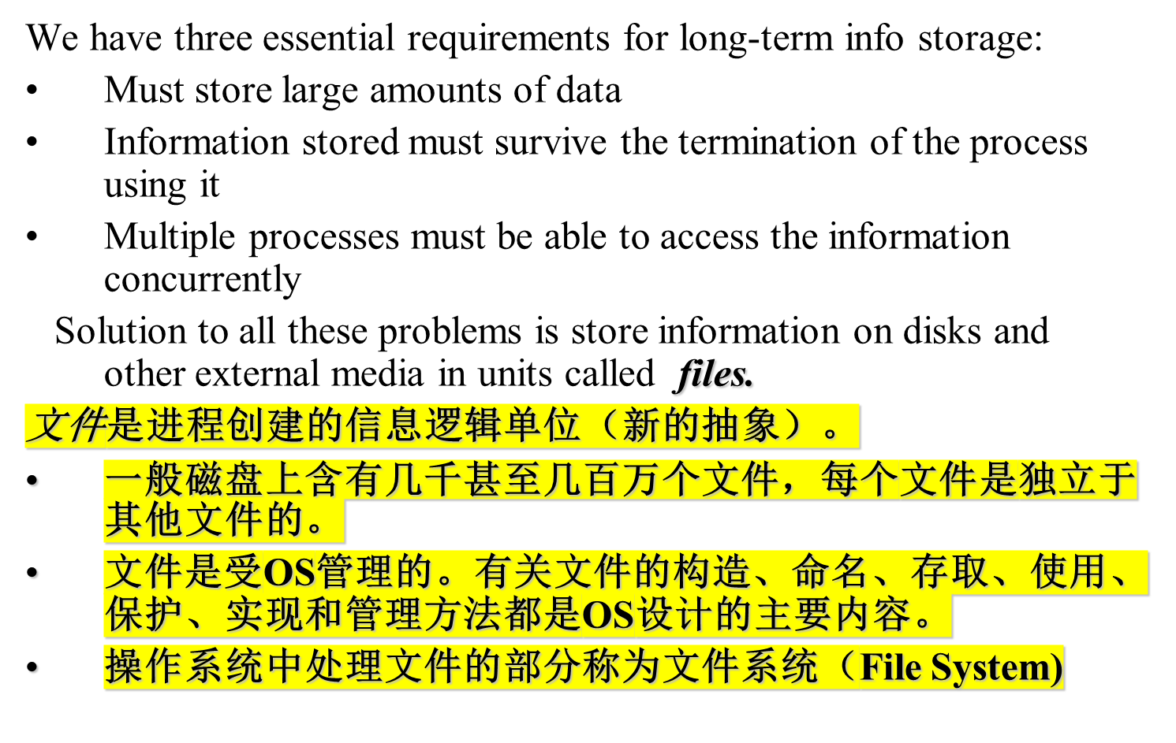
Long-term Information Storage

Slide 3

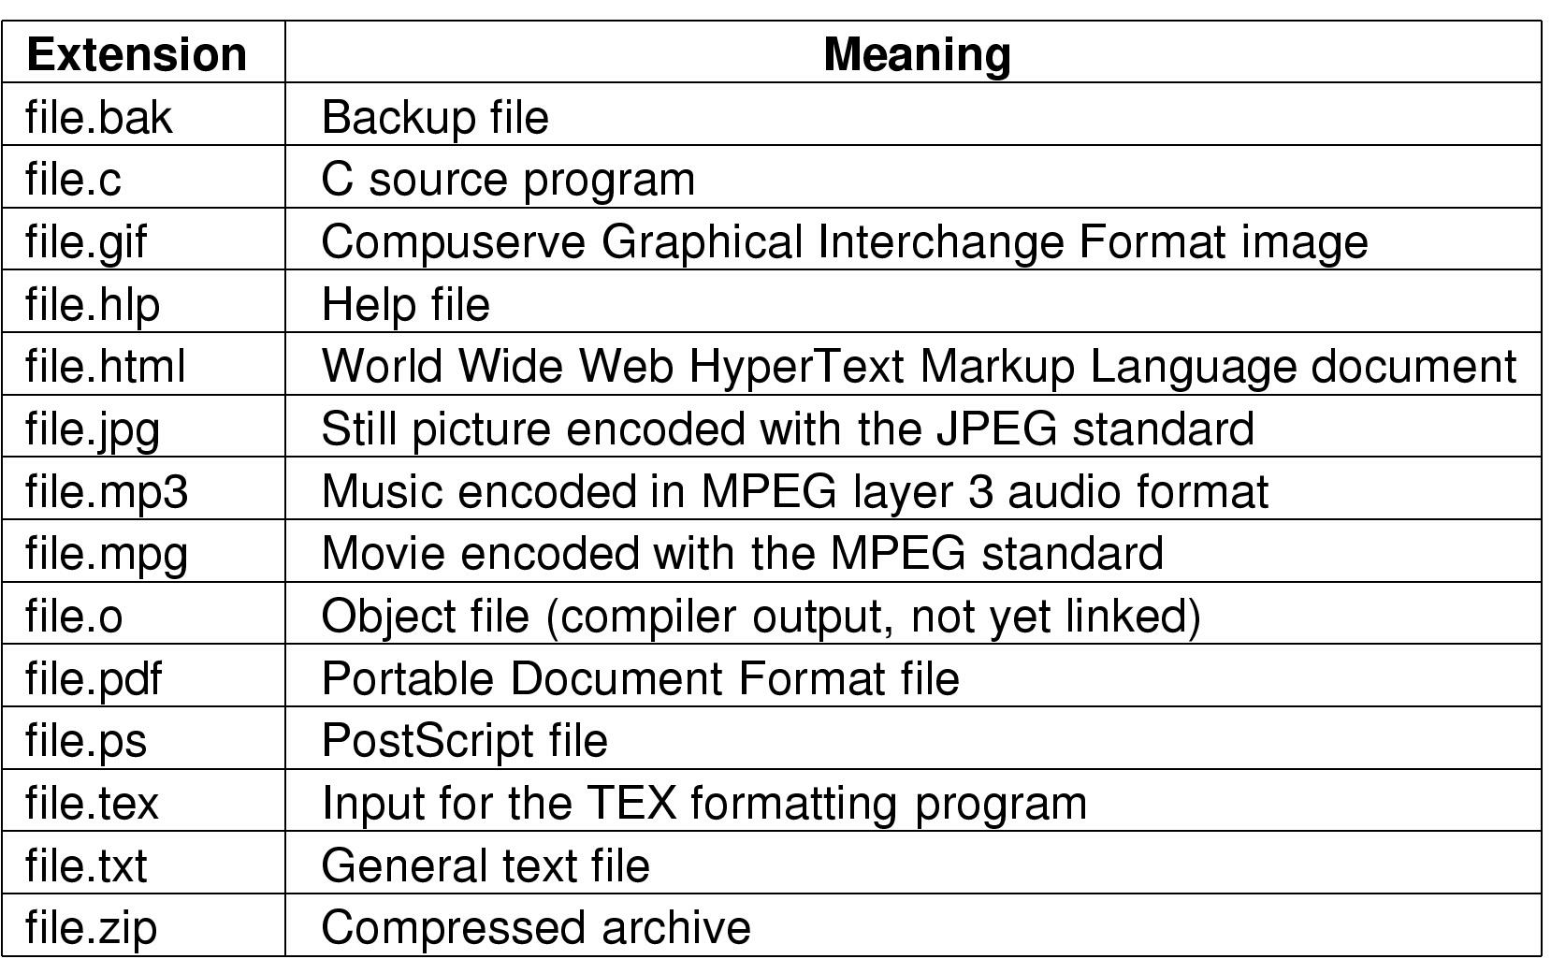
Some typical file extensions.

Slide 4
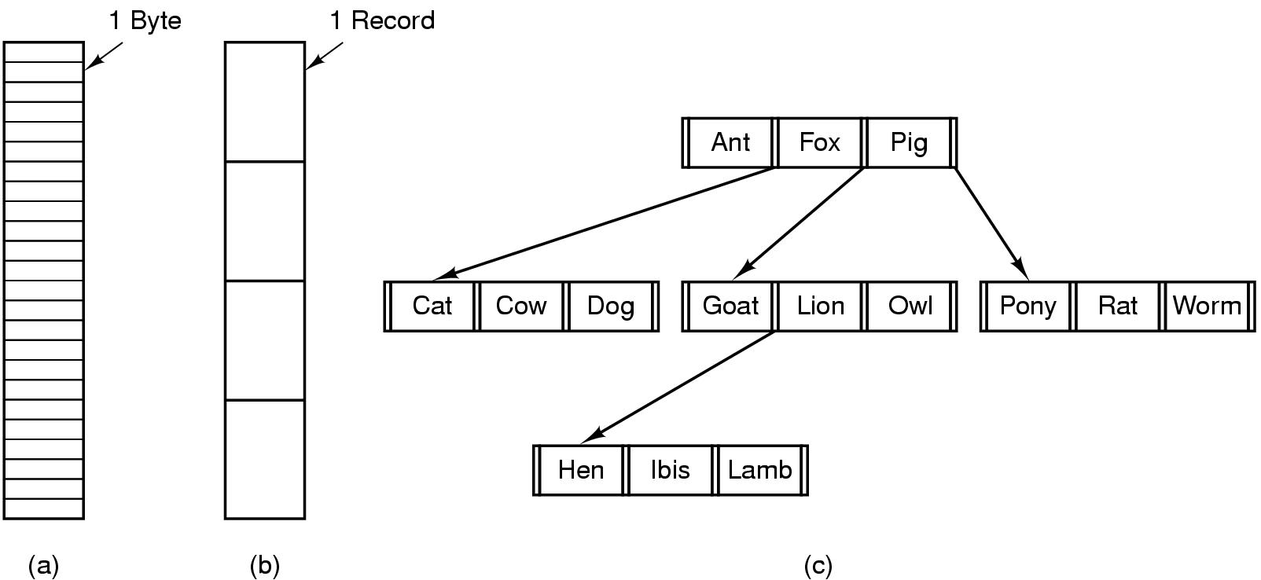
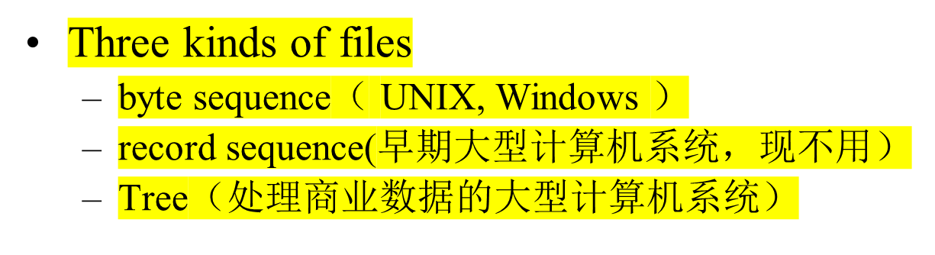
File Structure (逻辑结构）

Slide 5
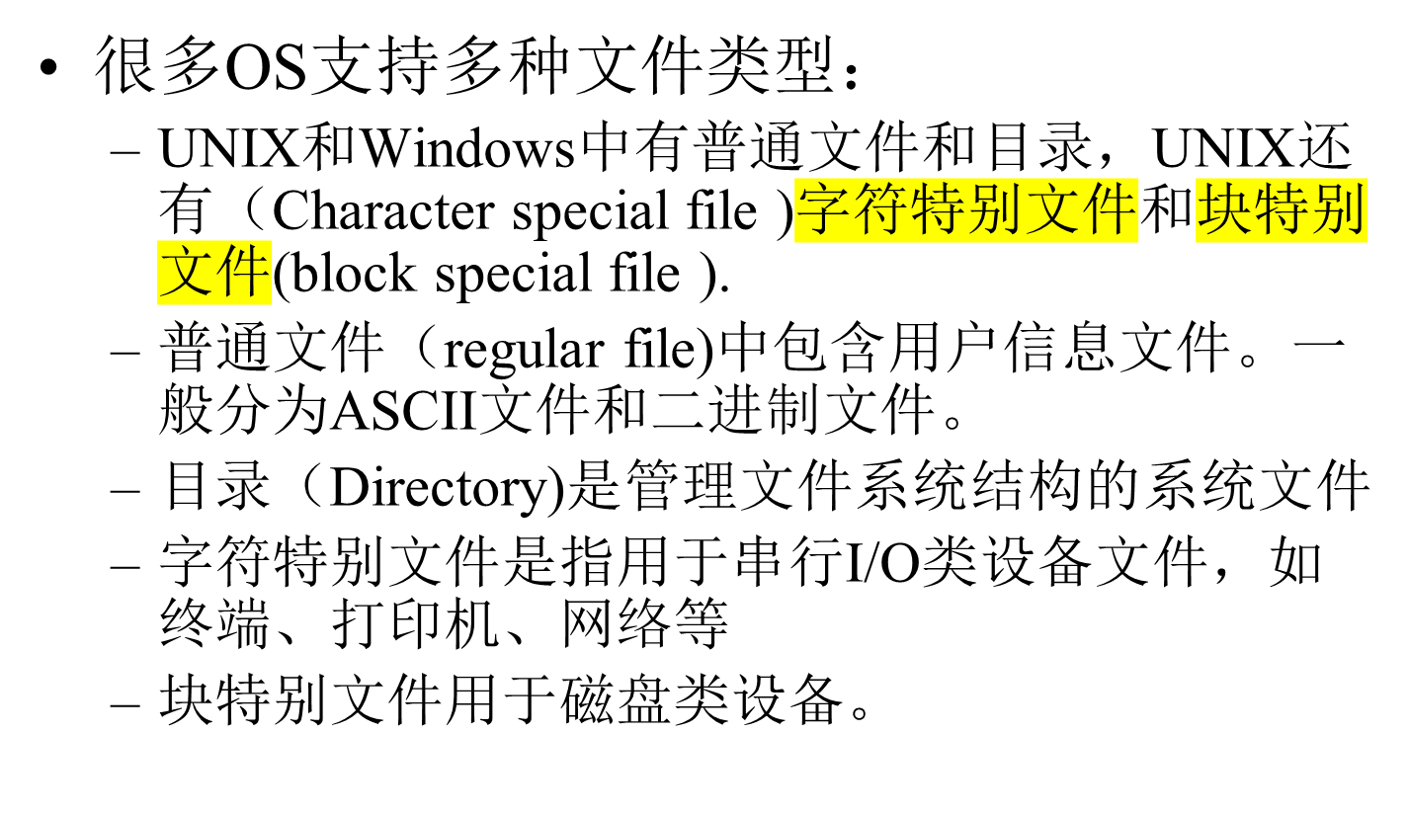
File Types

Slide 6
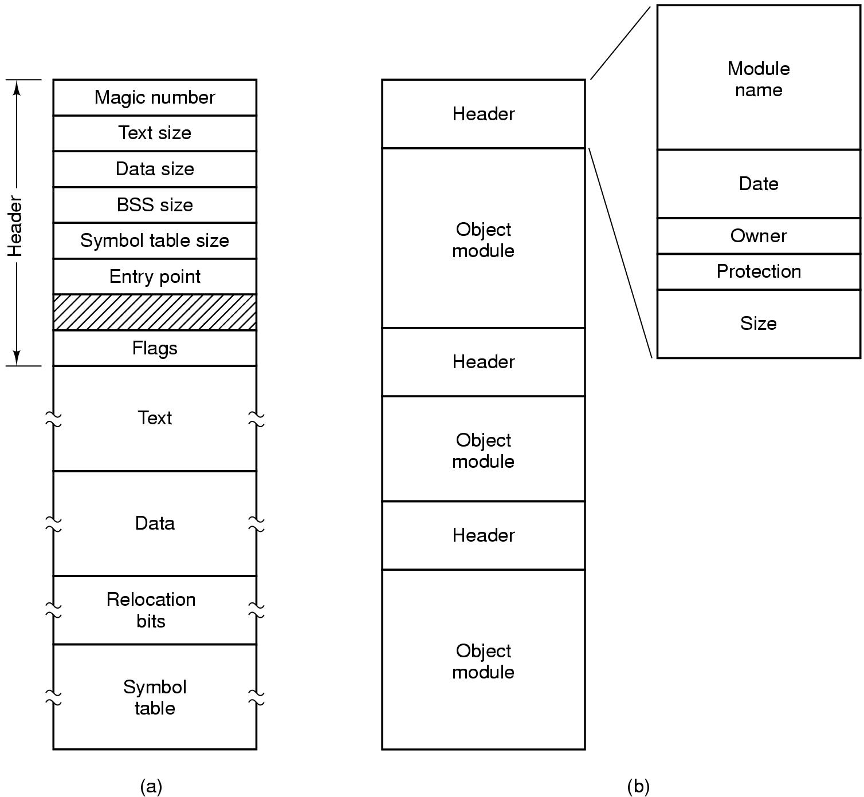
File Types
(a) An executable file （二进制） (b) An archive（存档文件，由已编译但没有连接的库过程（模块）集合而成）

Slide 7
File Access
Sequential access
  read all bytes/records from the beginning
  cannot jump around, could rewind or back up
  convenient when medium was mag tape
Random access
  bytes/records read in any order
  essential for data base systems
  read can be …
    move file marker (seek), then read or …
    read and then move file marker

Slide 8
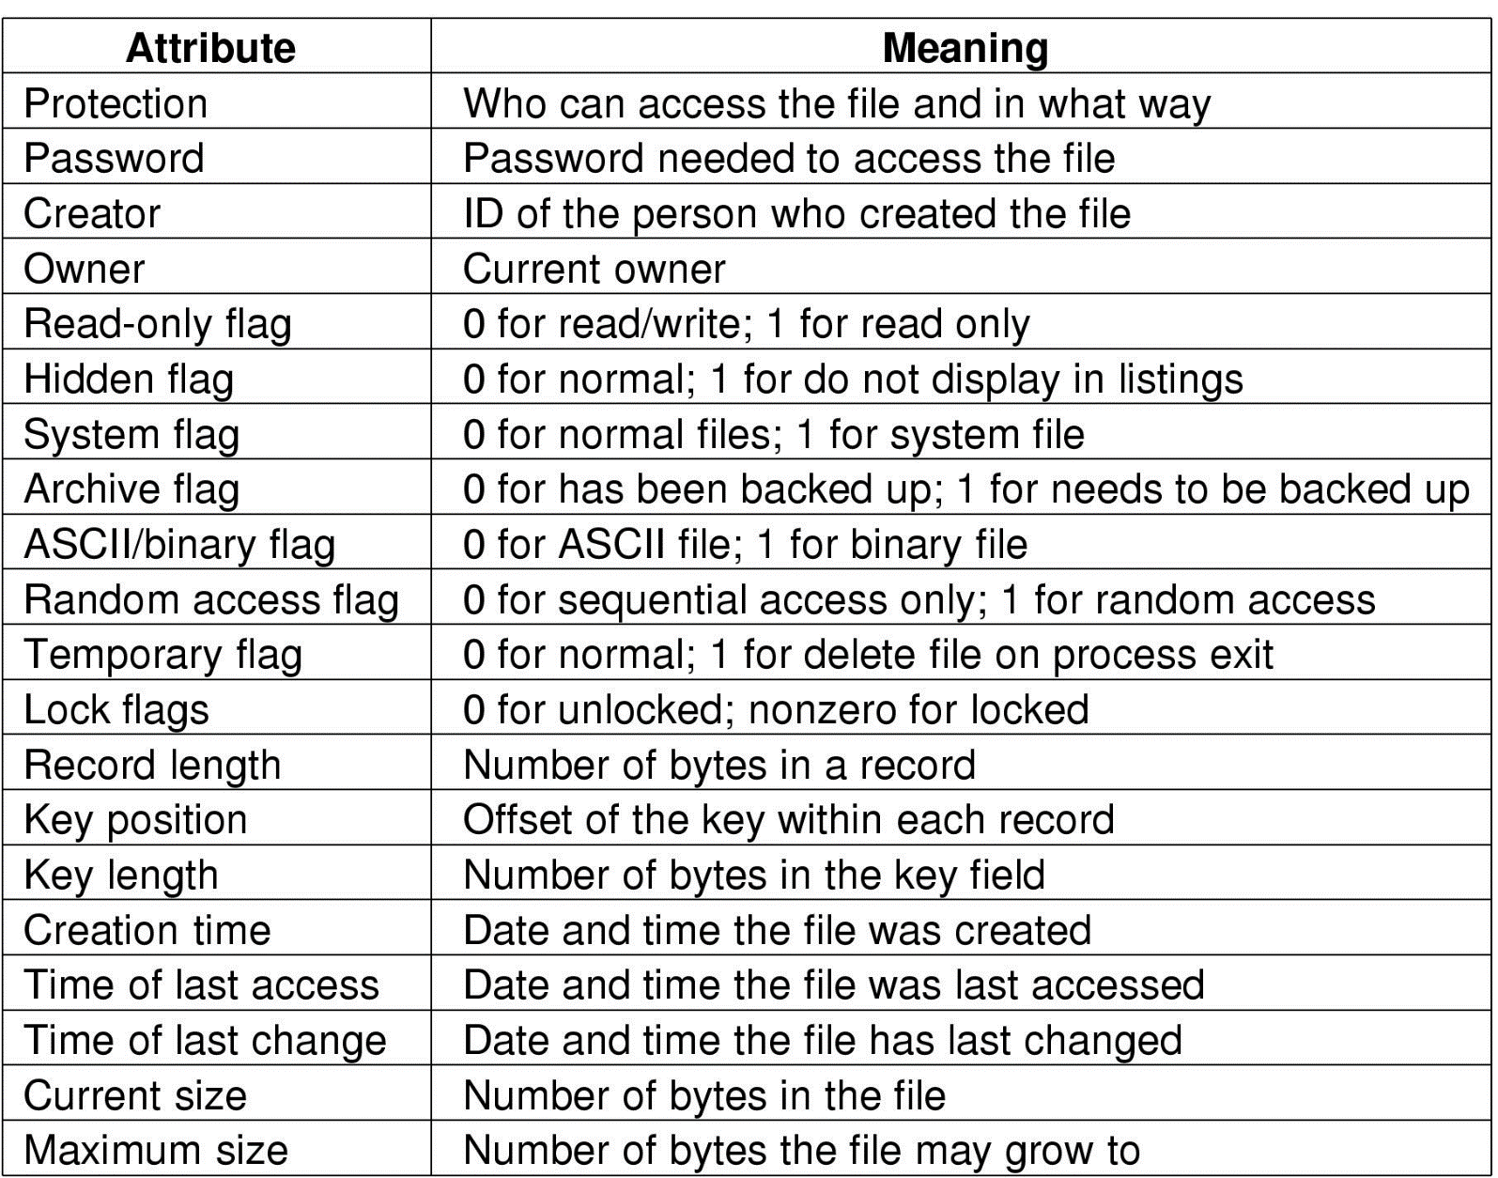
File Attributes (metadata)—文件相关信息
Possible file attributes

Slide 9
File Operations
The most common system calls relating to files:
  Create
  Delete
  Open
  Close
  Read
  Write
  Append
  Seek
  Get attributes
  Set Attributes
  Rename

Slide 10
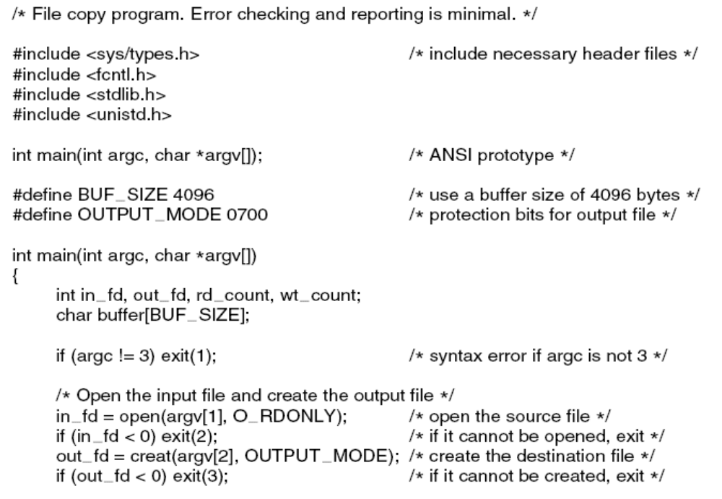
Example Program Using File System Calls (1)
---- A simple program to copy a file
. . .
Figure 4-5. A simple program to copy a file.

Slide 11
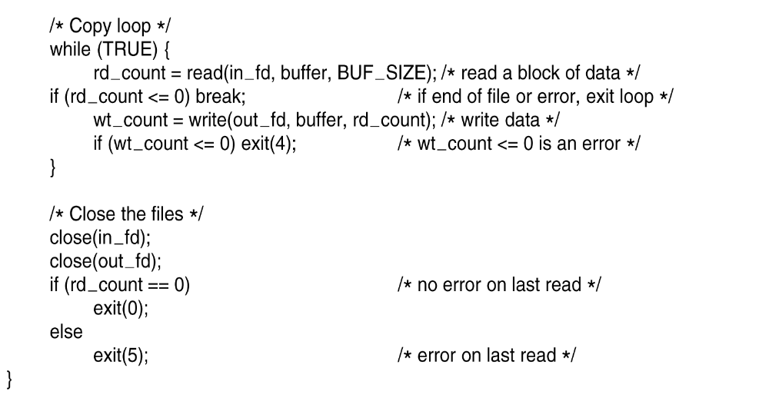
Example Program Using File System Calls (2)
Figure 4-5. A simple program to copy a file.

Slide 12
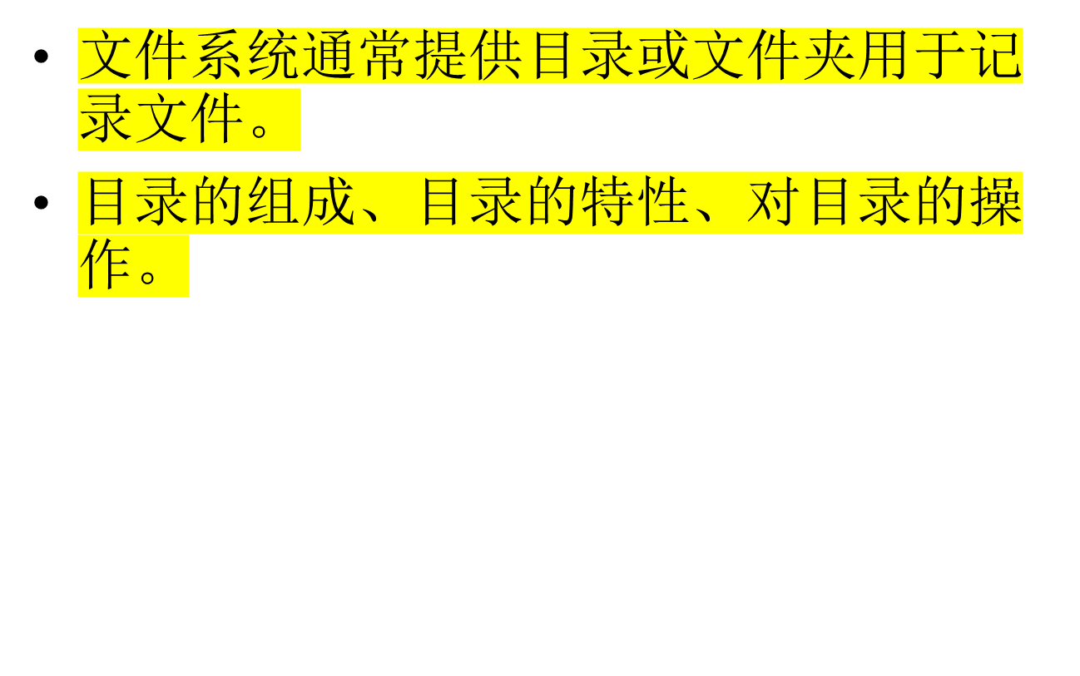
Directories

Slide 13
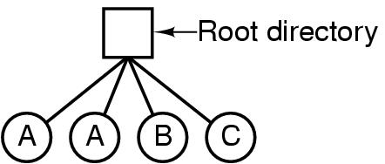
Directories
Single-Level Directory Systems
(一级目录系统)
A single level directory system
  contains 4 files
  owned by 3 different people, A, B, and C

Slide 14
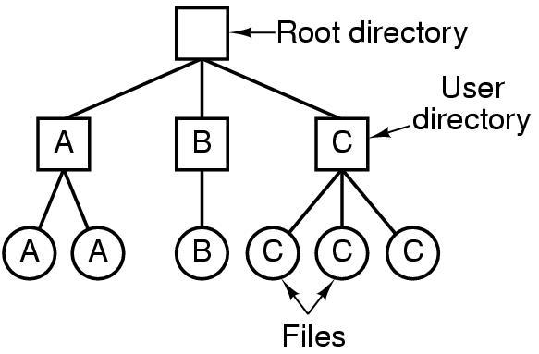
Two-level Directory Systems
(二级目录系统)
Letters indicate owners of the directories and files

Slide 15
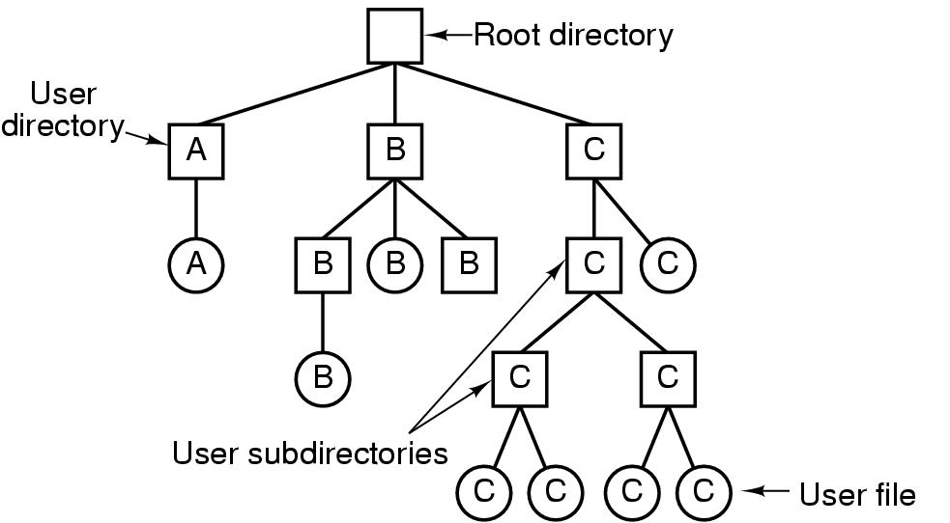
Hierarchical Directory Systems
层次目录系统
A hierarchical directory system

Slide 16
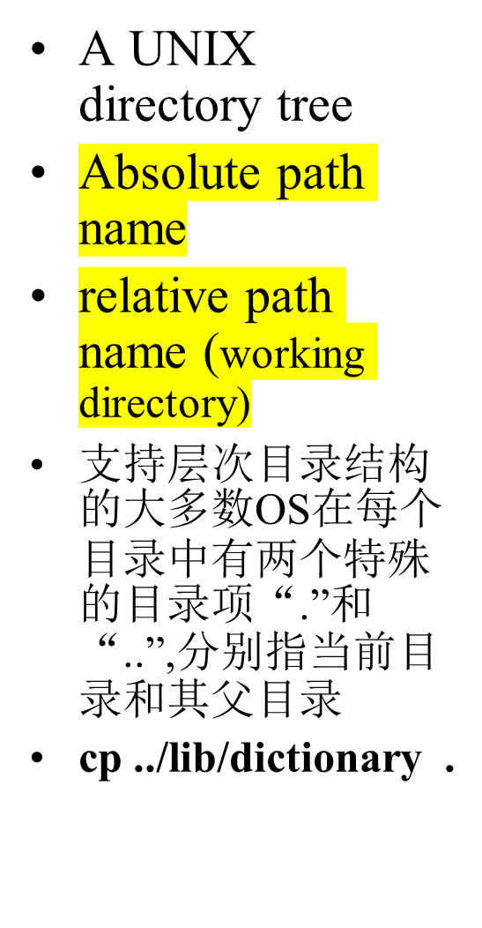
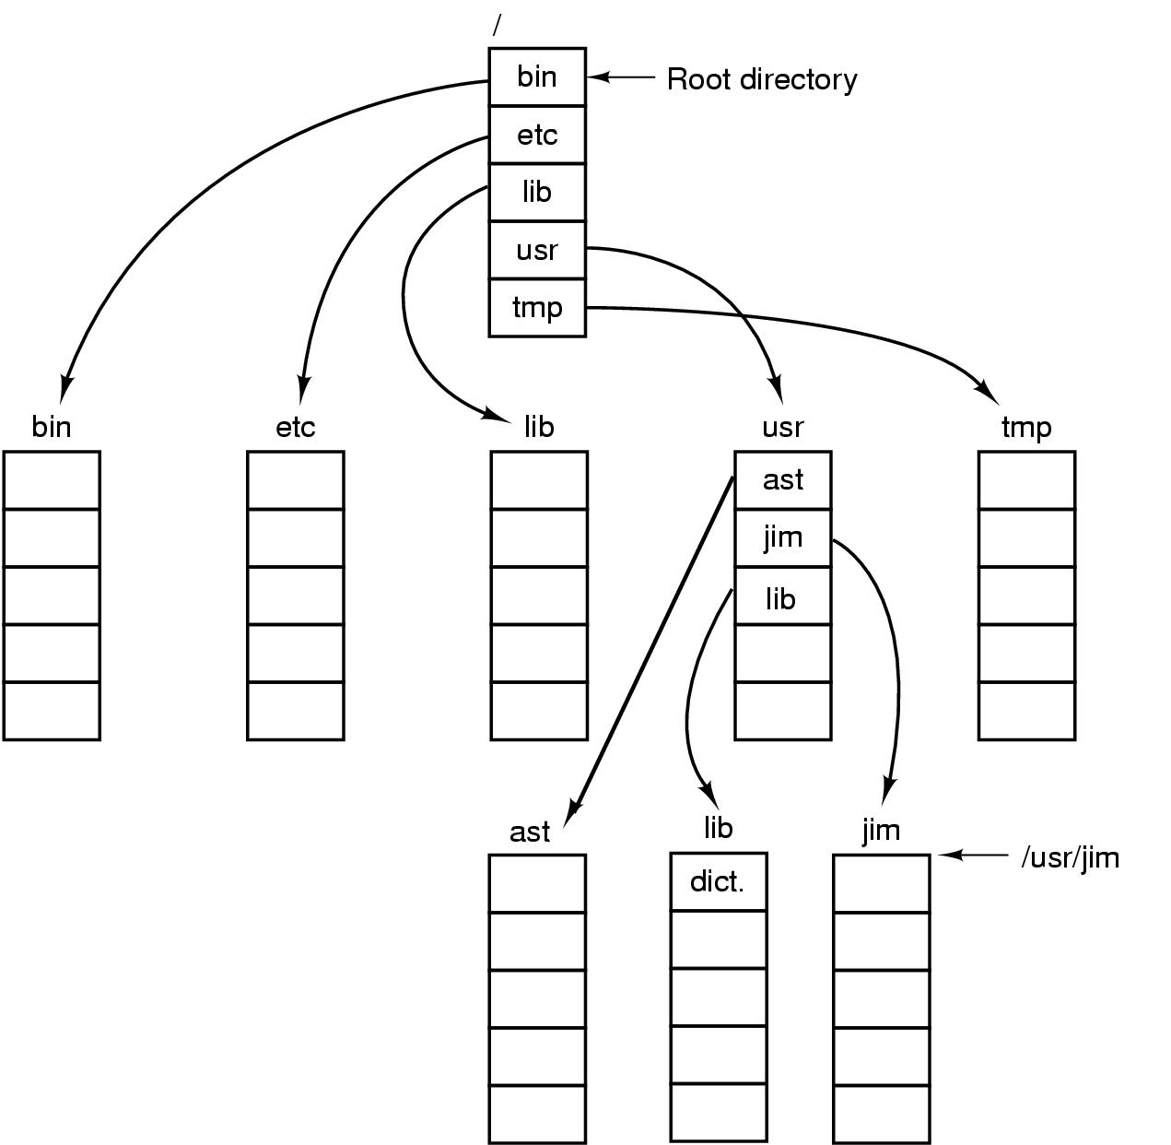
Path Names

Slide 17
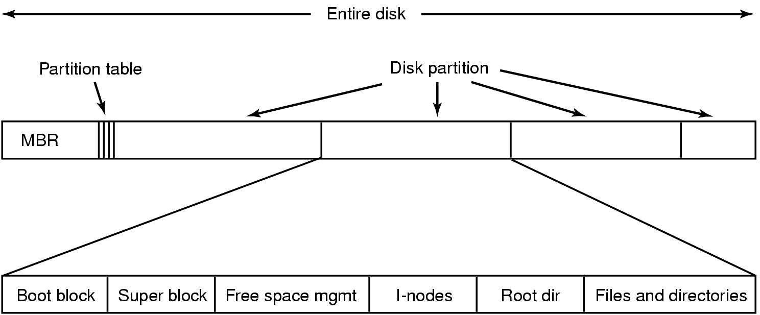
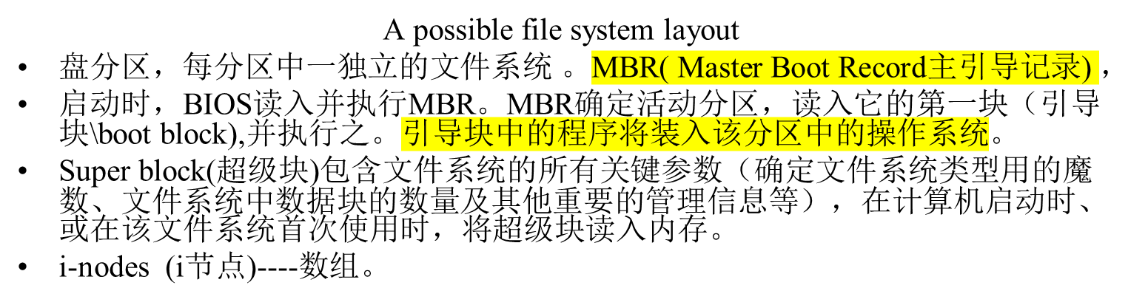
File System Implementation
—文件系统布局

Slide 18

Implementing Files --（文件存储） Contiguous allocation
(a) Contiguous allocation of disk space for 7 files
(b) State of the disk after files D and E have been removed
特点:实现简单,读性能较好;但随时间流失,磁盘会变得零碎.
适应于CD-ROM,DVD以及其他一次性写光学戒指

Slide 19

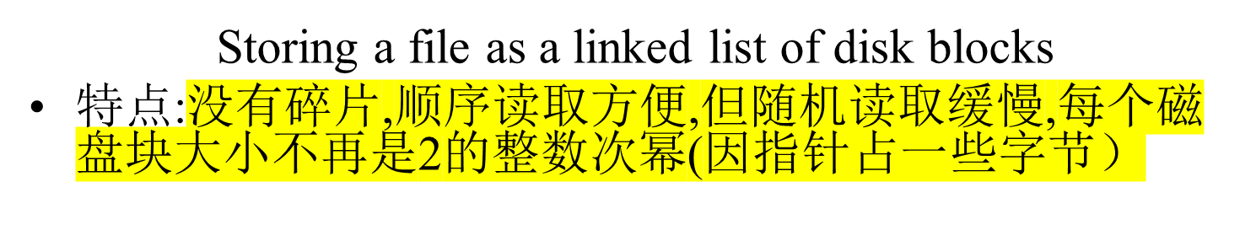
Implementing Files -- Linked List Allocation

Slide 20
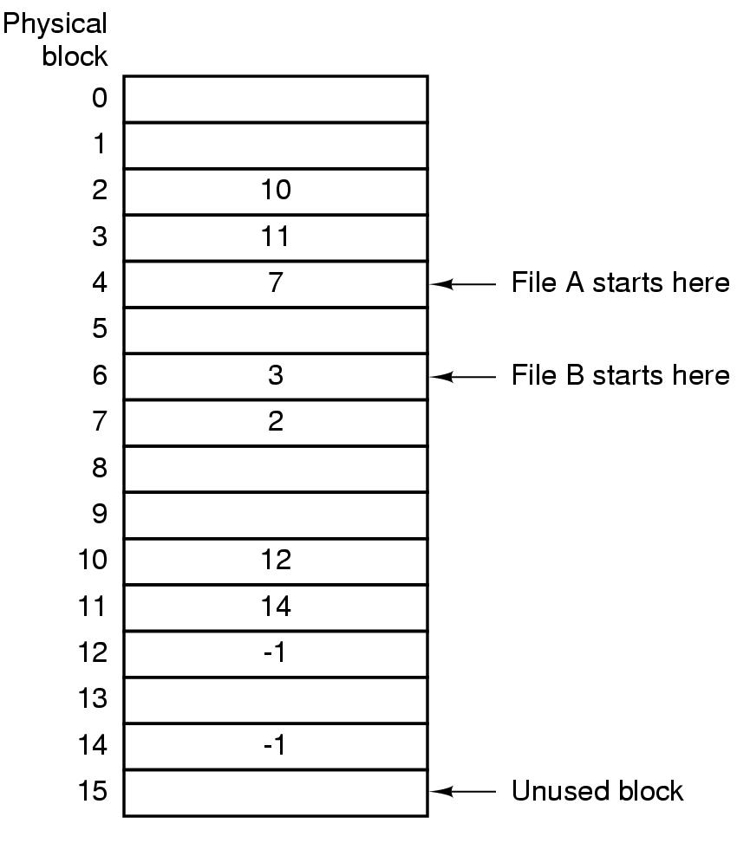
Implementing Files--Linked list allocation using a table in RAM
Linked list allocation using a file allocation table in RAM---FAT (File Allocation Table)
特点:可随机存取. 但表占内存空间大.FAT方案对于大磁盘不太合适。

Slide 21
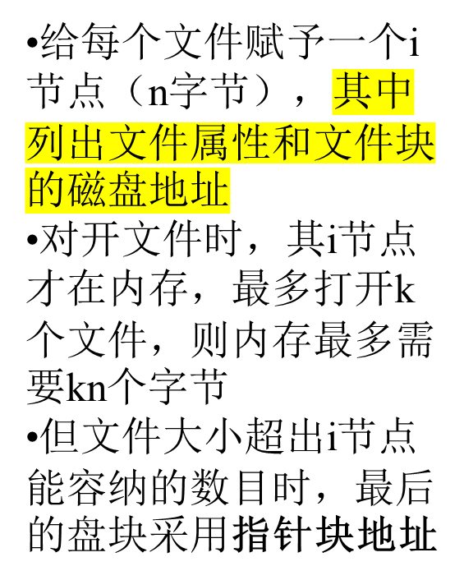
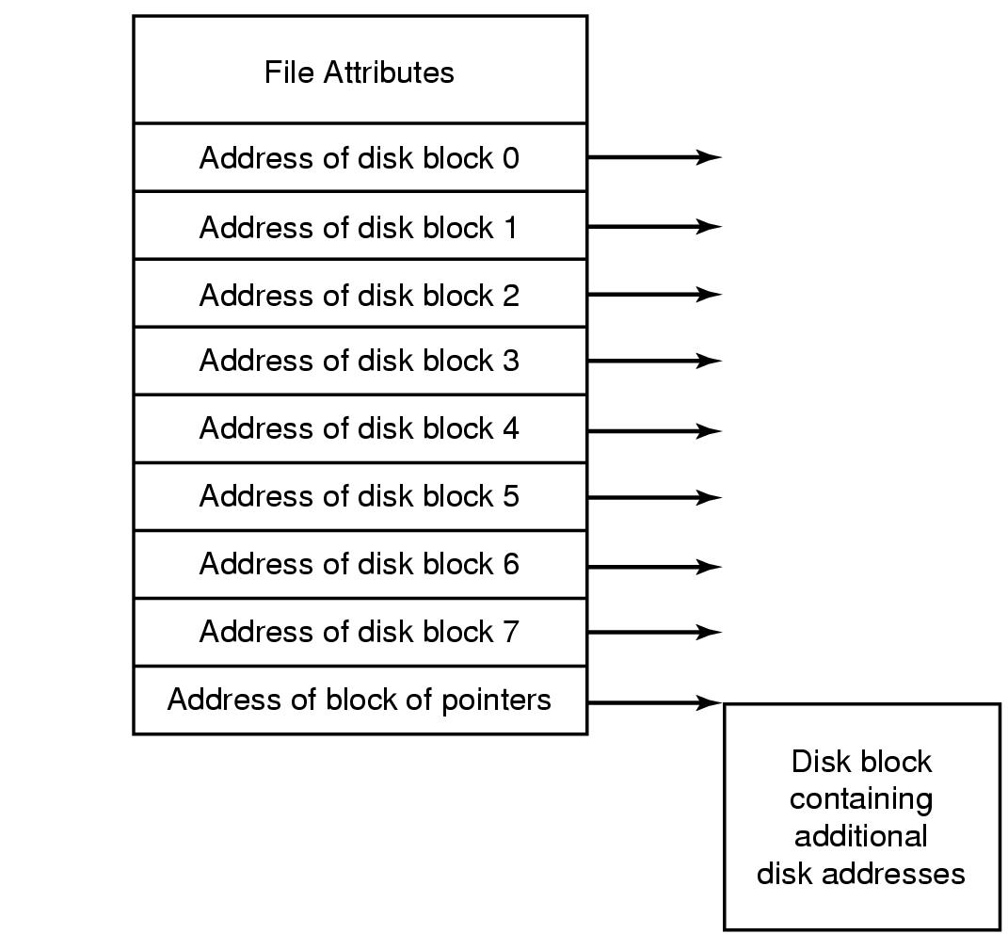
Implementing Files -- i-node（index-node)
An example i-node

Slide 22

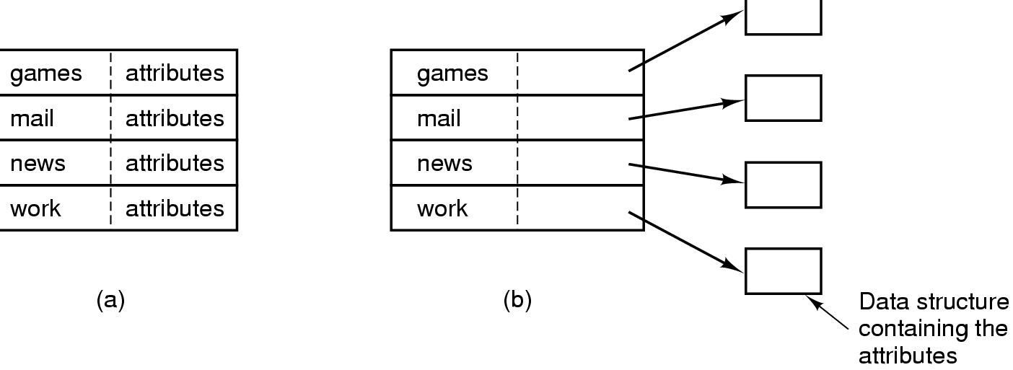
(a) A simple directory:fixed size entries,
  disk addresses and attributes in directory entry(WINDOWS)
(b) Directory in which each entry just refers to an i-node（UNIX）

Slide 23
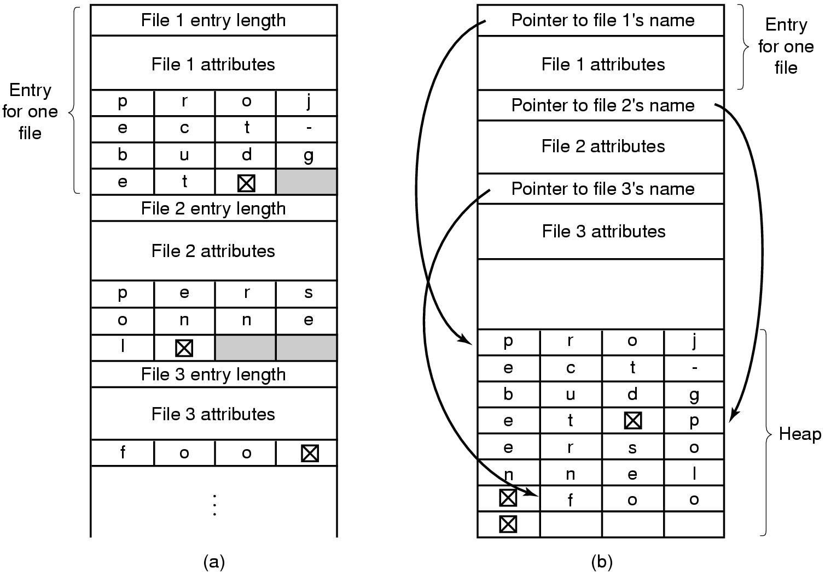
Implementing Directories
- handling long file names in directory
Two ways of handling long file names in directory
  (a) In-line (行内方式）:每个文件名被填充成整数个字.（将引入长度可变空隙，一个目录项可能分布在多个页面上）
  (b) In a heap (堆方式）：目录项都有固定长度，将文件名放置在目录后面的堆中

Slide 24
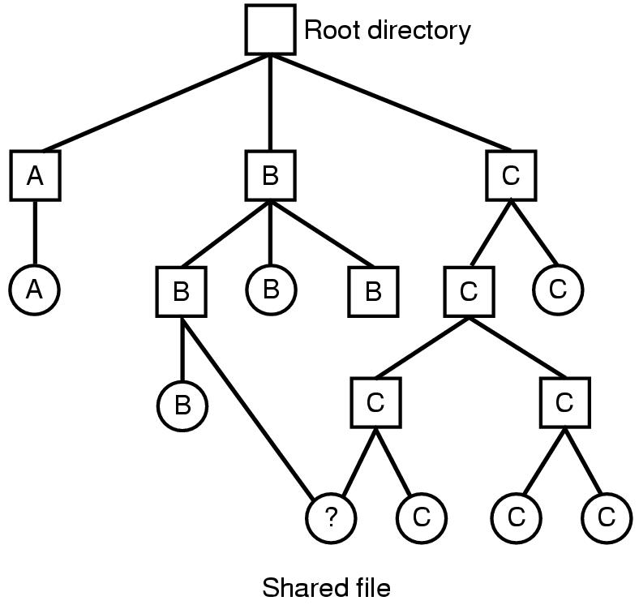
Shared Files (1)
File system containing a shared file

Slide 25
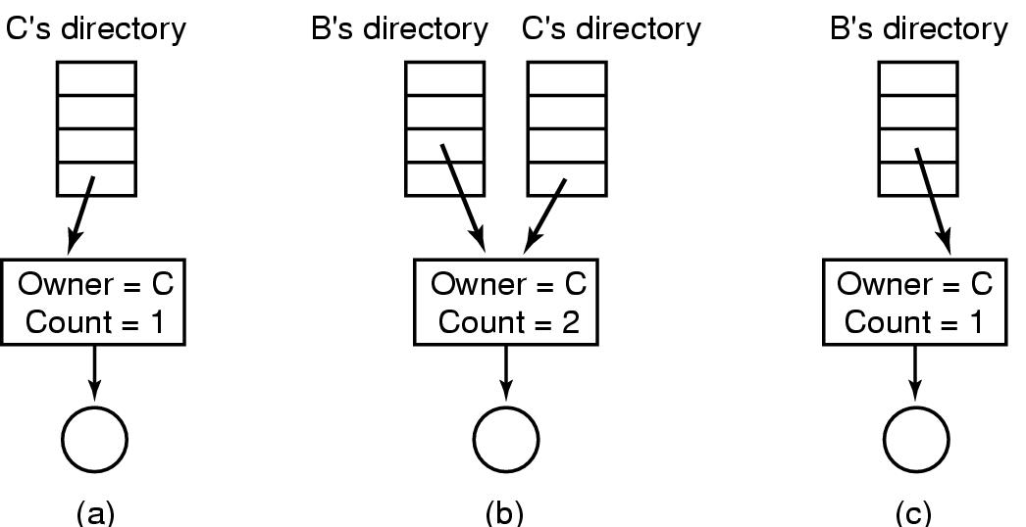
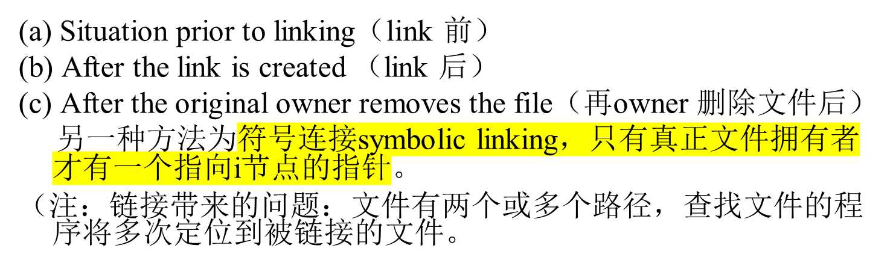
Shared Files (2)

Slide 26
Log-Structured File Systems（1）
With CPUs faster, memory larger
  disk caches can also be larger
  increasing number of read requests can come from cache
  thus, most disk accesses will be writes（写操作往往是零碎的）
LFS Strategy structures entire disk as a log（i节点分散在整个日志中，而不是放在磁盘的某个固定位置,建立i节点图）
  have all writes initially buffered in memory
  when file opened, locate i-node（从i节点图）, then find blocks
  periodically write these to the end of the disk log
  设立一个“清理线程”周期地扫描日志进行磁盘压缩。

Slide 27
Log-Structured File Systems（2）
设立一个“清理线程”周期地扫描日志进行磁盘压缩。
  清理线程首先读取日志中的第一个段的摘要，检查有哪些i节点和文件；然后查看i节点图，判断该i节点是否有效以及文件块是否仍在使用，如果没有使用，则该信息被丢去，如果仍然使用，那么i节点和块就进入内存等待写回到下一段中，原来的段则被标记为空闲，以便日志可以将它来存放新的数据。
  清理线程遍历日志：从后面移走旧的段，然后将有效的数据放入内存等待写回到下一个段中。由此磁盘成为一个大的环形的缓冲区，写进程将新的段写在前面，而清理线程则将旧的段从后面移走。
  LFS在处理大量的零碎的写操作时的性能优于UNIX ,且在读和大块写操作的性能方面也不比UNIX文件系统差。

Slide 28
Journaling File Systems（吸收LFS思想）
基本思想：保存一个用于记录系统下一步将要做什么的日志，当系统在完成即将完成的任务前崩溃时，重新启动后，可以查看日志, 获取崩溃前计划完成的任务，并完成它们。如 微软的NTFS和Linux的ext3和ReiserFS.
Operations required to remove a file in UNIX（删除文件时，需要的三步）:
Remove the file from its directory.
Release the i-node to the pool of free i-nodes.
Return all the disk blocks to the pool of free disk blocks.

Slide 29

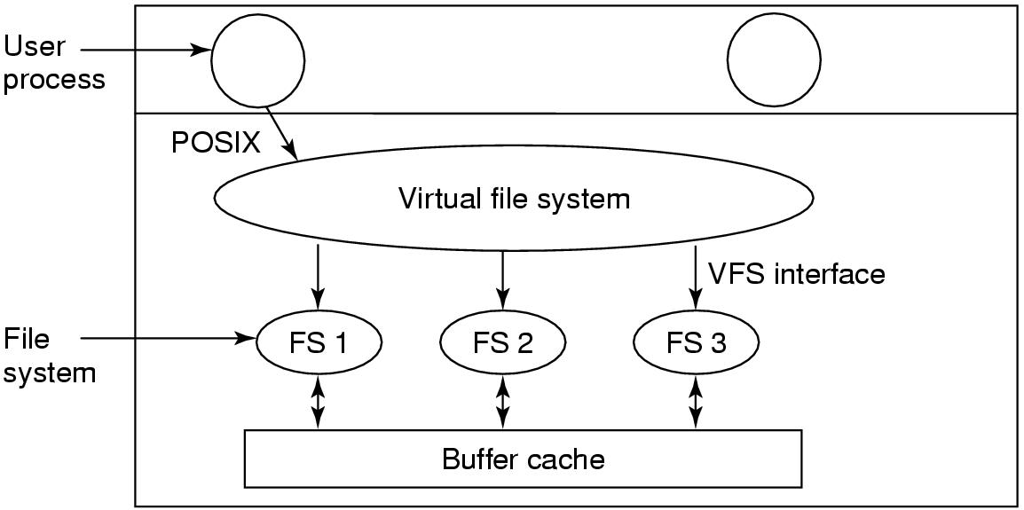
Virtual File Systems (1)
Figure 4-18. Position of the virtual file system.

Slide 30
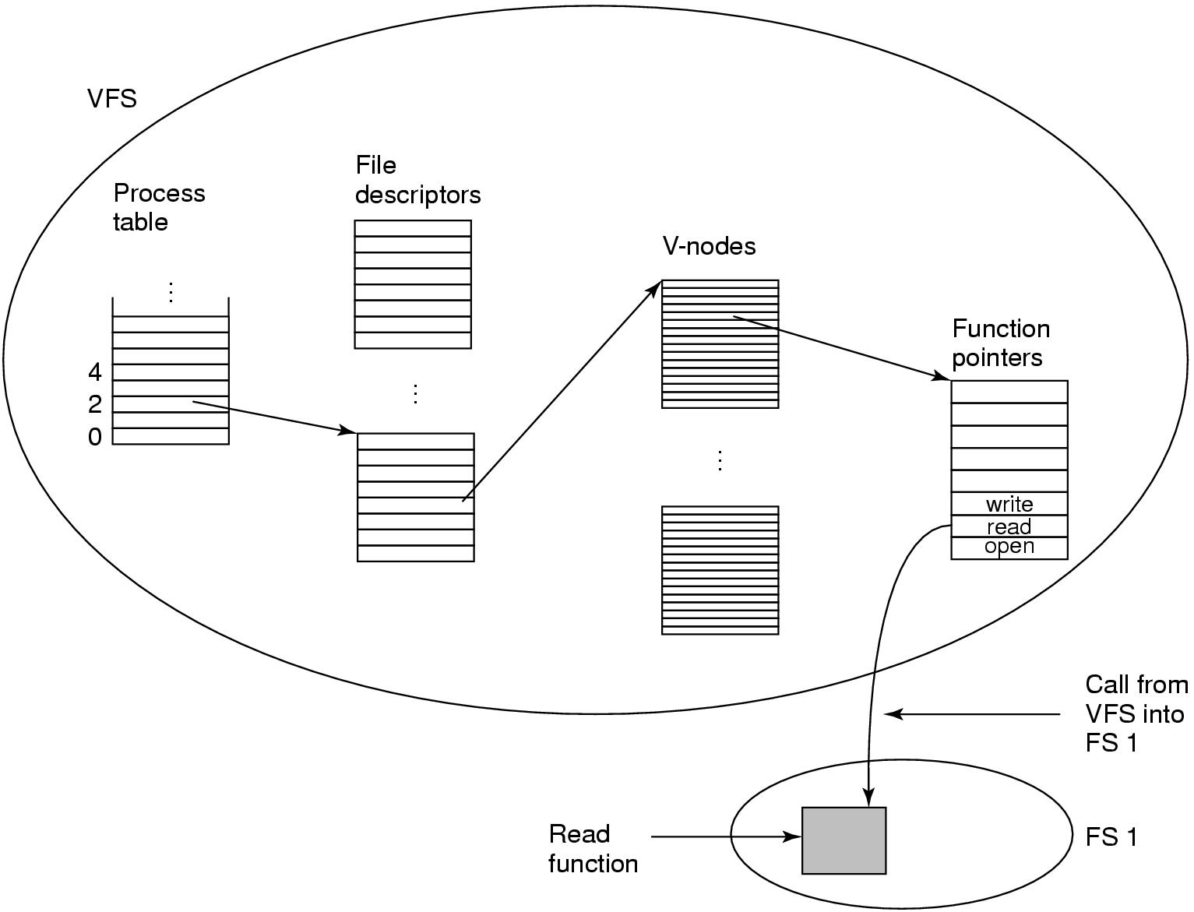
Virtual File Systems (2)
Figure 4-19. A simplified view of the data structures and code used by the VFS and concrete file system to do a read.

Slide 31
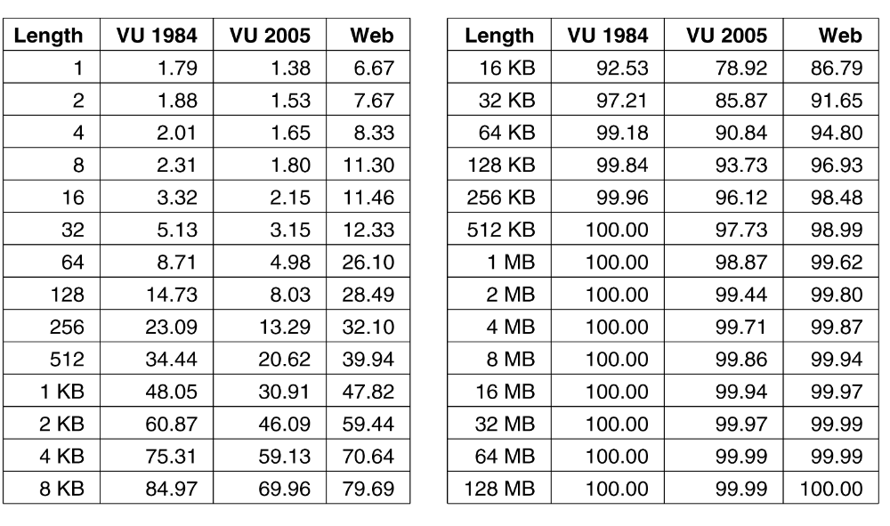

Disk Space Management ----Block Size (1)
Figure 4-20. Percentage of files smaller than a given size
(in bytes)（小于某个给定值（字节）的文件的百分数）.

Slide 32
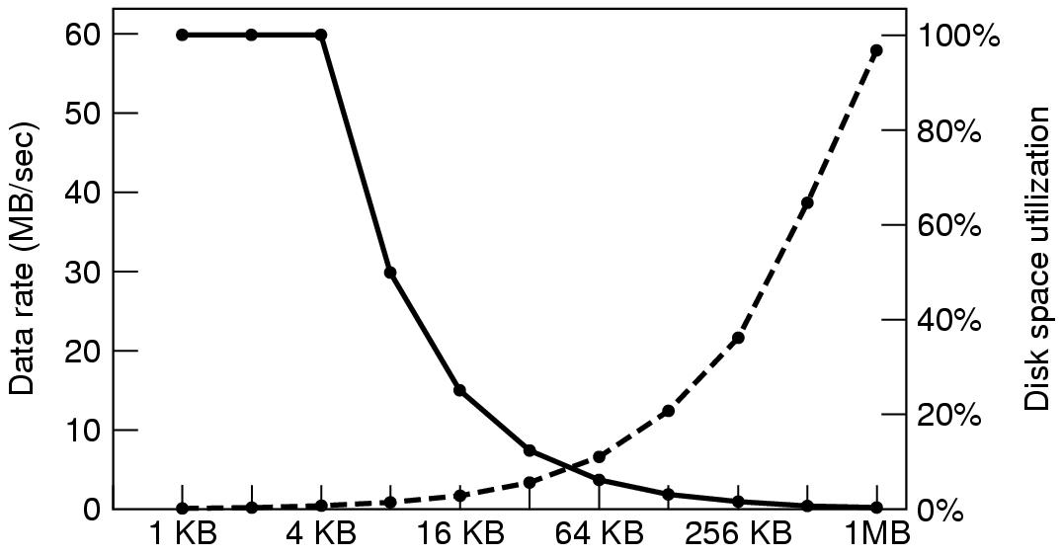
Disk Space Management –Block Size（2）
Block size
Dark line(实线) (left hand scale) gives data rate of a disk（磁盘数据率）
Dotted line(虚线) (right hand scale) gives disk space efficiency（磁盘利用率）
All files 4KB

Slide 33
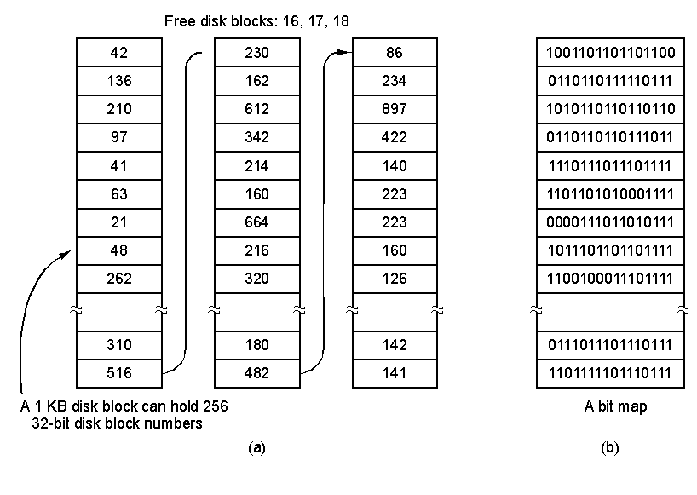
Disk Space Management
–Keeping Track of Free Blocks(1)
(a) Storing the free list on a linked list (b) A bitmap

Slide 34
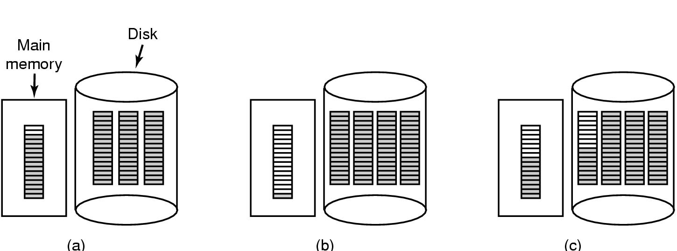
Disk Space Management
–Keeping Track of Free Blocks (2)
(a) Almost-full block of pointers to free disk blocks in RAM
  - three blocks of pointers on disk
(b) Result of freeing a 3-block file
(c) Alternative strategy for handling 3 free blocks(采用拆分满的指针块.
  - shaded entries are pointers to free disk blocks

Slide 35
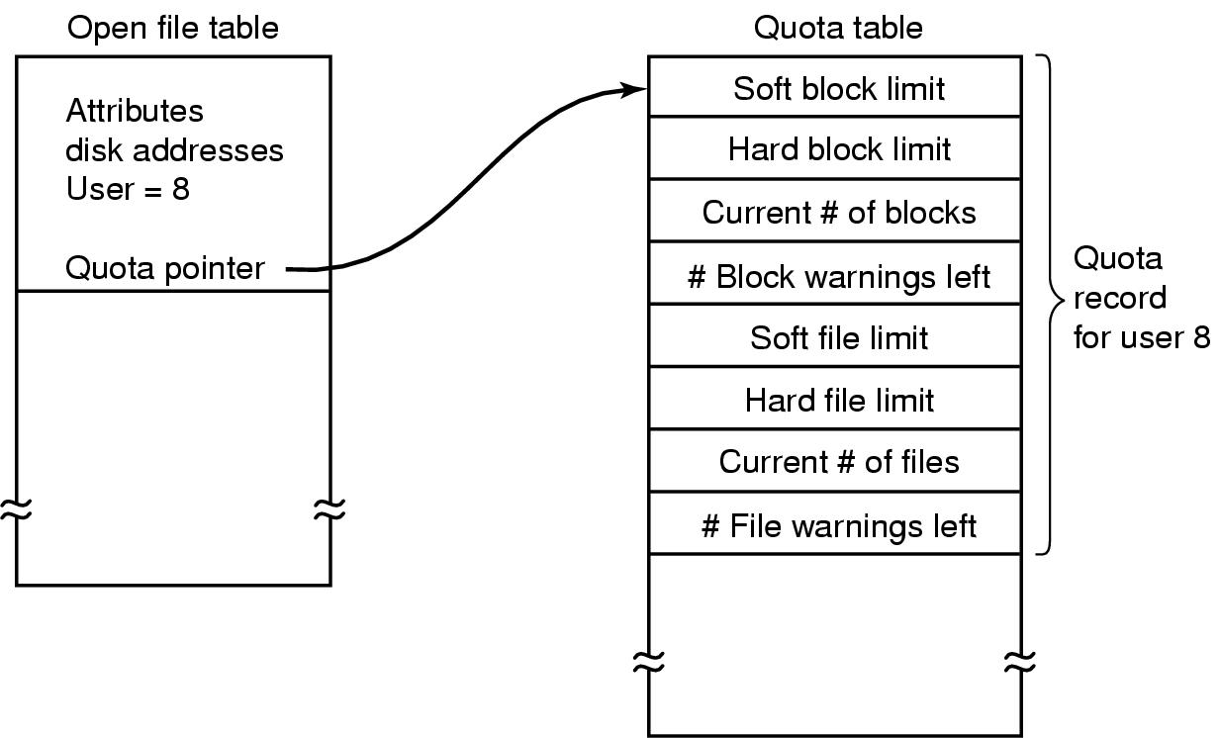
Disk Space Management –Disk Quotas（磁盘配额）
Quotas are kept track of on a per-user basis in a quota table.

Slide 36
File System Backups (1)
Backups to tape are generally made to handle one of two potential problems:
Recover from disaster（从意外的灾难中恢复）.
Recover from stupidity. (从错误的操作中恢复）
转储磁盘到磁带上有两种方案：物理转储（从磁盘的第0块开始，全部按序输出到磁带上）和逻辑转储（从一个或几个指定的目录开始，递归地转储其自给定基准日期后所更改的全部文件和目录）。

Slide 37
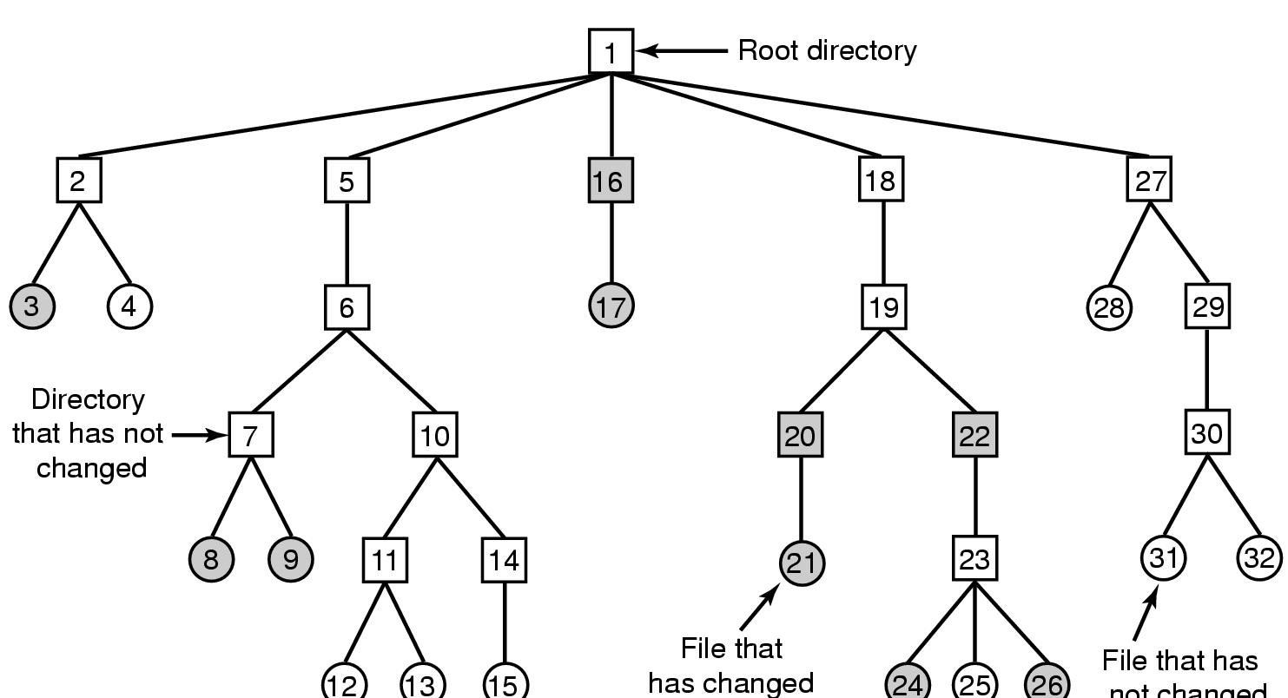
File System Backups (2)
File that has
not changed
A file system to be dumped
  squares are directories, circles are files
  shaded items, modified since last dump
  each directory & file labeled by i-node number

Slide 38
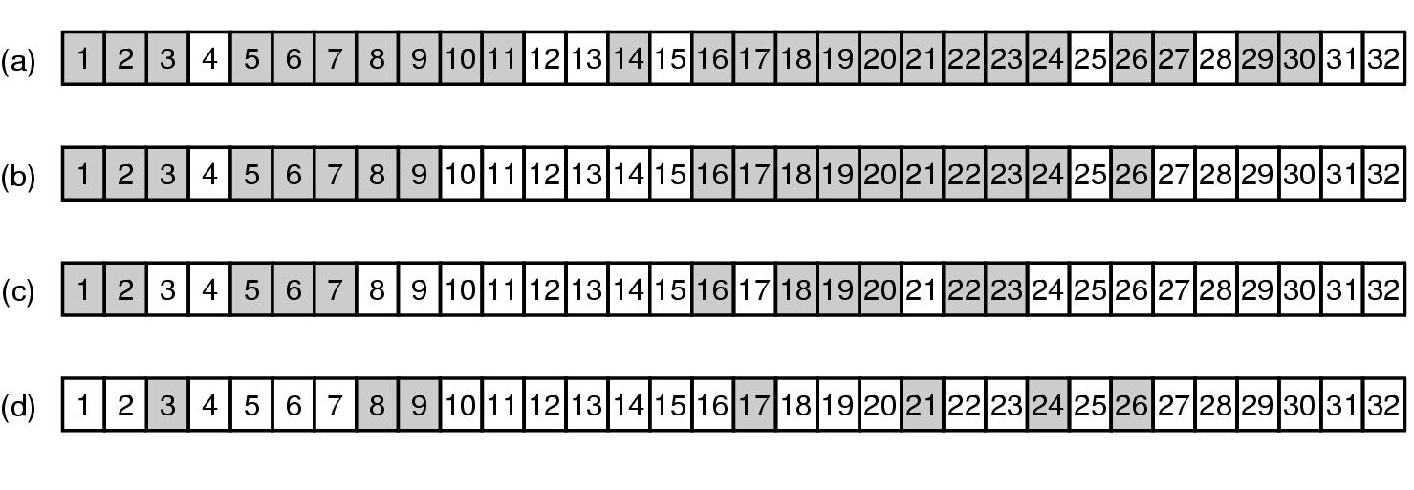
File System Backups (3)
Bit maps used by the logical dumping algorithm

Slide 39
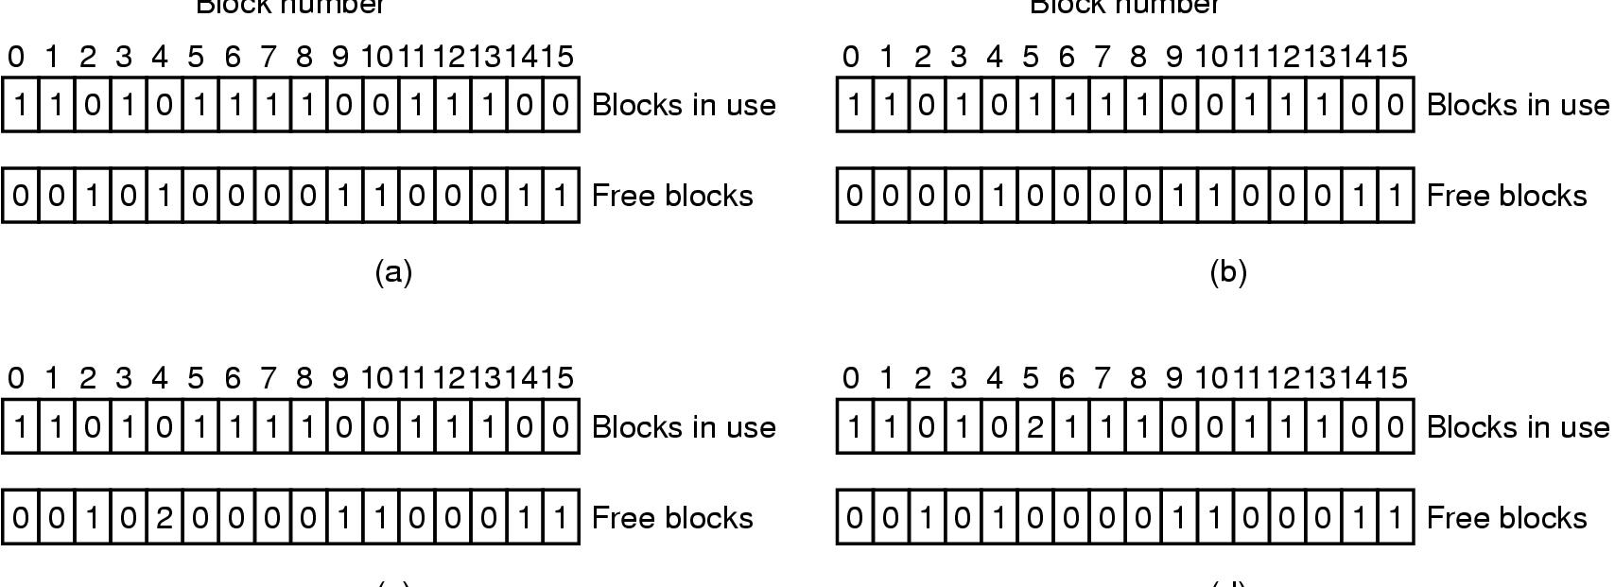
File System Reliability (1)
File system states
  (a) Consistent (b) missing block
  (c) duplicate block in free list (d) duplicate data block

Slide 40
File System Performance –-Block Read Ahead
Get blocks into the cache before they are needed to increase the hit rate.
When the file system is asked to produce block k in a file, it schedules a read for block k+ 1.
The file system keep track of the access patterns to each open file.

Slide 41

File System Performance –Reducing Disk Arm Motion
I-nodes placed at the start of the disk
Disk divided into cylinder groups
  each with its own blocks and i-nodes

Slide 42
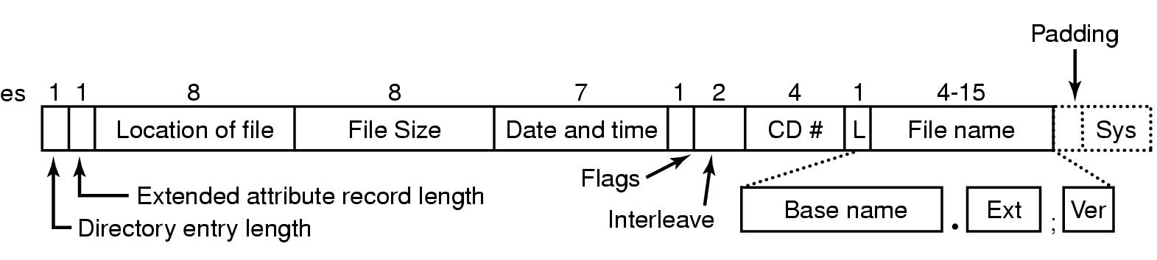
Example File Systems
CD-ROM File Systems
The ISO 9660 directory entry

Slide 43
Rock Ridge Extensions
Rock Ridge extension fields:
PX - POSIX attributes.
PN - Major and minor device numbers.
SL - Symbolic link.
NM - Alternative name.
CL - Child location.
PL - Parent location.
RE - Relocation.
TF - Time stamps.

Slide 44
Joliet Extensions
Joliet extension fields:
Long file names.
Unicode character set.
Directory nesting deeper than eight levels.
Directory names with extensions

Slide 45
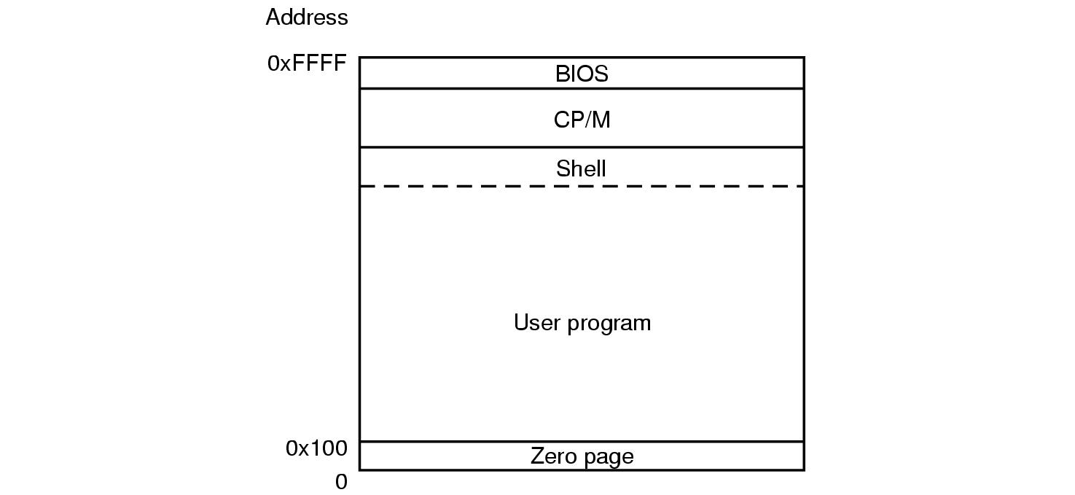
The CP/M File System (1)
Memory layout of CP/M

Slide 46
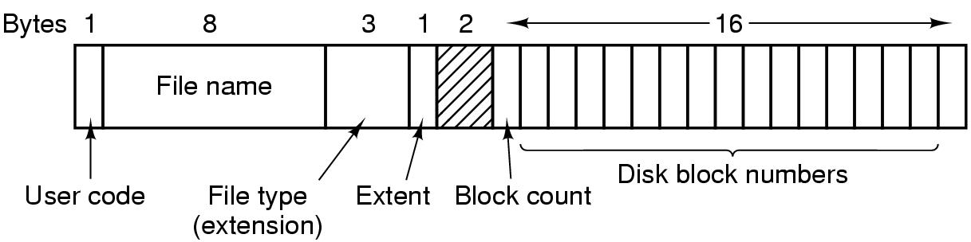
The CP/M File System (2)
The CP/M directory entry format

Slide 47
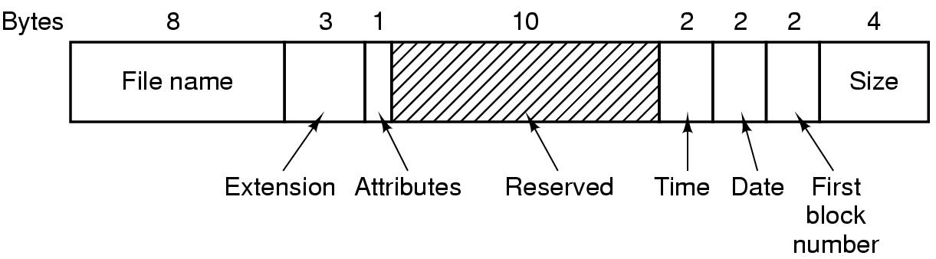
The MS-DOS File System (1)
The MS-DOS directory entry

Slide 48
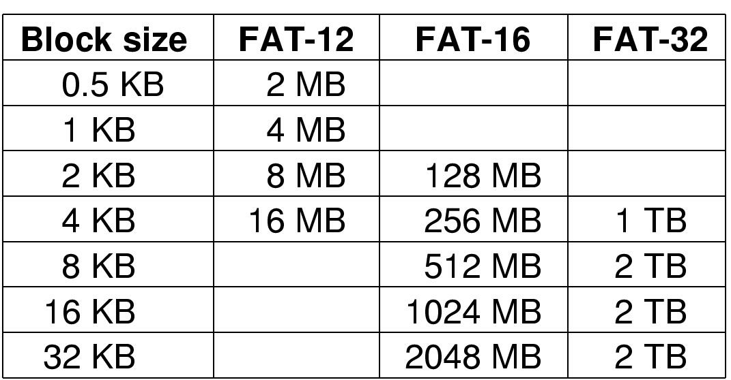
The MS-DOS File System (2)
Maximum partition for different block sizes
The empty boxes represent forbidden combinations

Slide 49
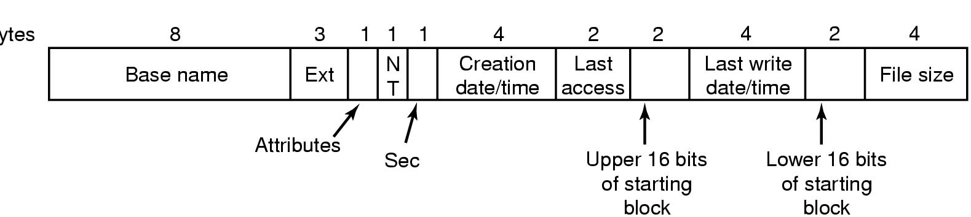
The Windows 98 File System (1)
Bytes
The extended MOS-DOS directory entry used in Windows 98

Slide 50
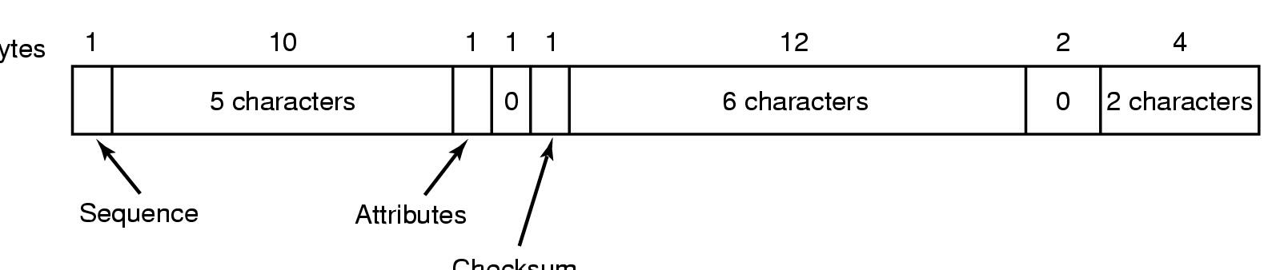
The Windows 98 File System (2)
Bytes
Checksum
An entry for (part of) a long file name in Windows 98

Slide 51
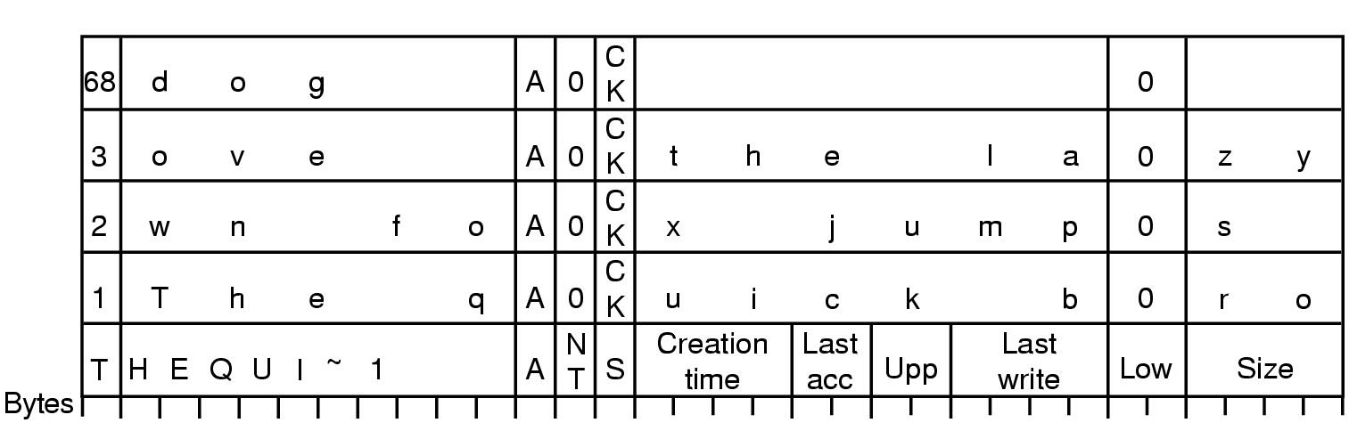
The Windows 98 File System (3)
An example of how a long name is stored in Windows 98

Slide 52
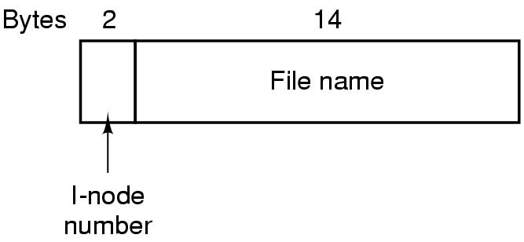
The UNIX V7 File System (1)
A UNIX V7 directory entry

Slide 53
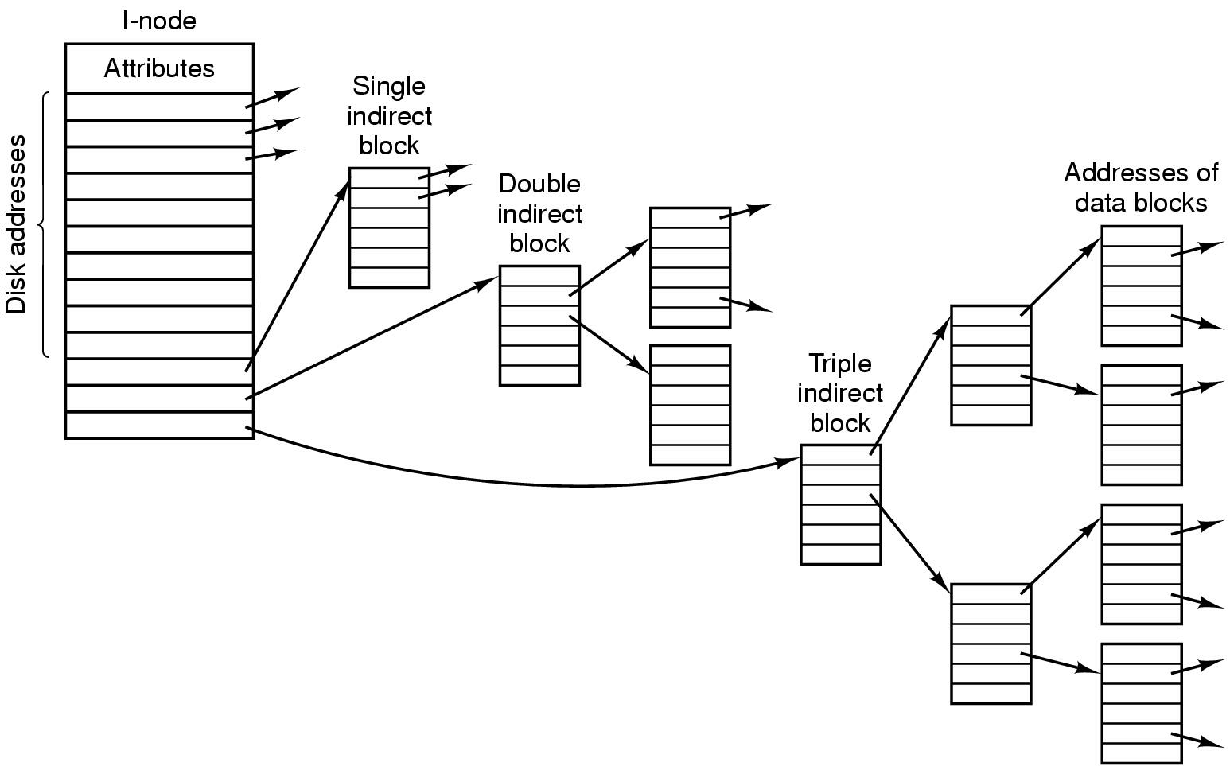
The UNIX V7 File System (2)
A UNIX i-node

Slide 54
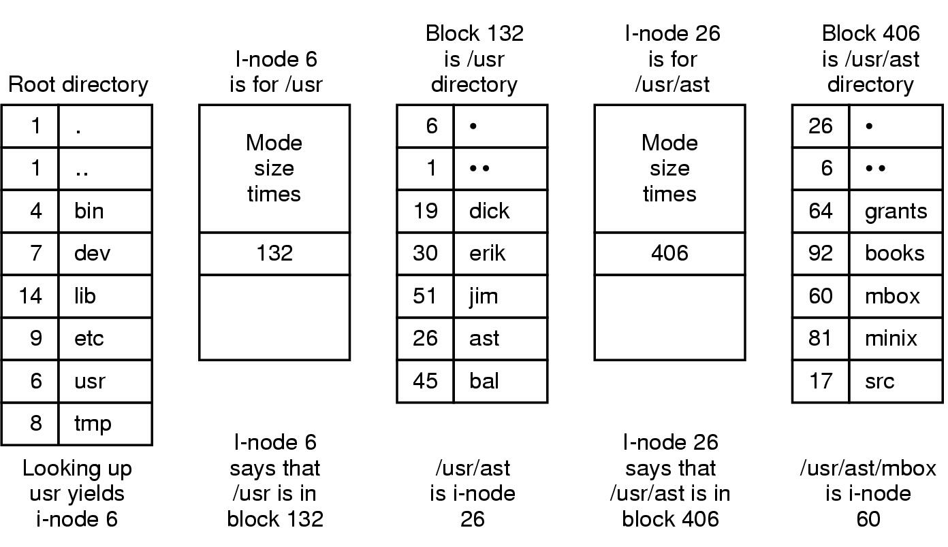
The UNIX V7 File System (3)
The steps in looking up /usr/ast/mbox

Slide 55
Summary
Files
Directories
File system implementation
File system Management and Optimize
Example file systems
P186--P187: 6，13，24，25，32，36,40

